Slide 1
Употребление в речи конструкции there is\there are к УМК «Spotlight» 5 класс
(авторы: Ваулина Ю.Е, Дули Д.)
учитель английского языка
МБОУ СОШ №15 с. Можарка
Даввыдова С. А.

Slide 2


This is my new house.
Hello! I am Ann.

Slide 3
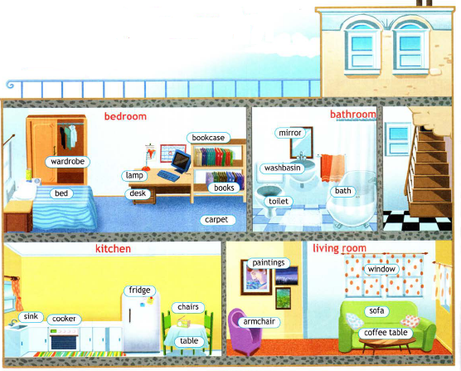
I have got 5 rooms in my house.
I have got a big kitchen in my house

Slide 6
Write down the first rule, please!

Slide 7
Look at the picture on page 48!

Slide 8
Write down the second rule, please!
единственном
множественном

Slide 9
There four chairs in the kitchen.
There a table in the dining room.
There a lamp on the table.
There five paintings on the wall.
There two windows in the bedroom.
There ten books in the bookcase.
Fill in the gaps, please!

Slide 10
Сheck yourself, please!
are
There four chairs in the kitchen.
There a table in the dining room.
There a lamp on the table.
There five paintings on the wall.
There two windows in the bedroom.
There ten books in the bookcase.
is
is
are
are
are

Slide 11
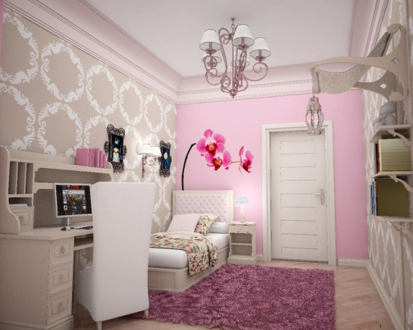
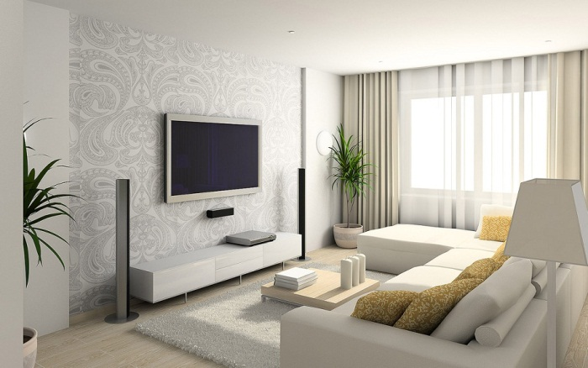
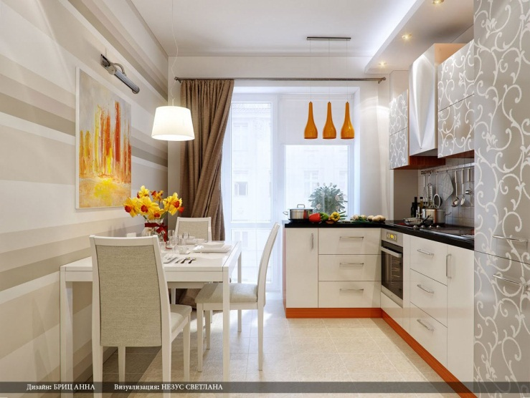
Look at the pictures and describe the rooms, please!

